Slide 1
Computer Organization and Architecture

Slide 2
Computer Architecture
Refers to those attributes of a system ,visible to a programmer
Example
Instruction set
No of bits used to represent diff data types(numbers, characters)
I/O mechanism
Techniques used for addressing memory

Slide 3
Computer Organization
Refers to operational units and their interconnections
Example
Hardware details transparent to programmer
Interface between computer and peripherals(devices connected to computer)
Memory technology used

Slide 4
Difference between Computer Architecture and Computer Organization
SR. No. | Computer Architecture | Computer Organization
1. | Architecture describes what the computer does. | The Organization describes how it does it.
2. | Computer Architecture deals with the functional behavior of computer systems. | Computer Organization deals with a structural relationship.
3. | As a programmer, you can view architecture as a series of instructions, addressing modes, and registers. | The implementation of the architecture is called organization.
4. | For designing a computer, its architecture is fixed first. | For designing a computer, an organization is decided after its architecture.
5. | Architecture coordinates the hardware and software of the system. | Computer Organization handles the segments of the network in a system.
6. | Examples- Intel and AMD created the x86 processor. Sun Microsystems and others created the SPARC processor. Apple, IBM, and Motorola created the PowerPC. | Organizational qualities include hardware elements that are invisible to the programmer, such as interfacing of computer and peripherals, memory technologies, and control signals.

Slide 5
Structure and Function
Structure: The way in which the components are interrelated
Functions: The operation of each individual components as part of the structure
Top down approach
Bottom up approach

Slide 6
Basic functions that computer can perform
Operating environment
(Source and destination of data(I/O))
Data Movement
Control Mechanism
Control data through instructions
Data Storage Facility
Data Processing Facility

Slide 7
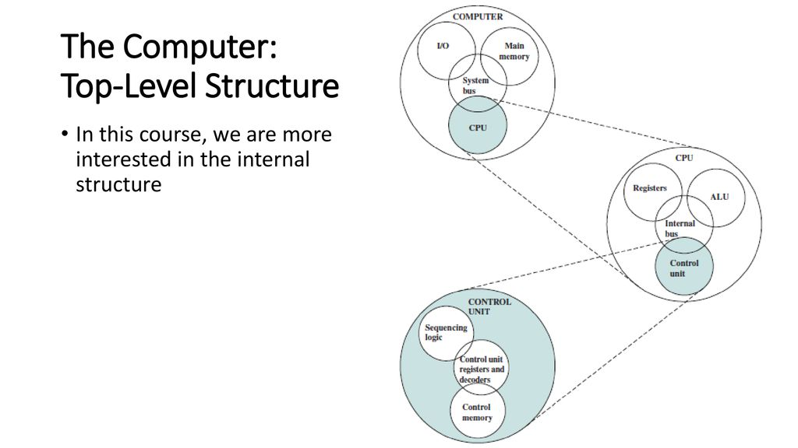

Slide 8
Structural Components
CPU(Processor): Controls the operation of computer and performs its data processing functions
Main Memory: Stores data
I/O: Moves data between computer and its external environment
System interconnections: mechanism provided for communication among CPU, main memory and I/O by means of system bus, which consist of number of connecting wires to which all other components attach

Slide 9
Components of CPU
Control unit: Controls the operation of the CPU
Arithmetic and logic unit(ALU): performs computer’s data processing functions
Registers: Provides storage internals to the CPU
CPU interconnection: mechanism provided for communication among ALU, CU and registers

Slide 10
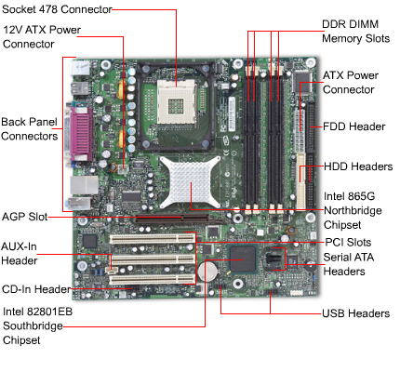
Hardware

Slide 11
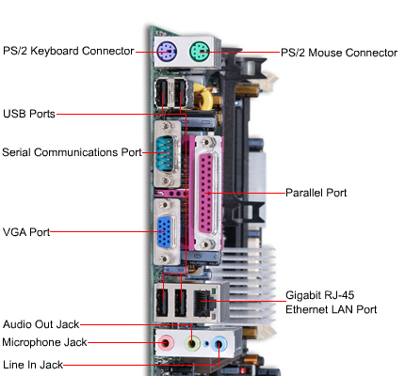
Motherboard

Slide 12
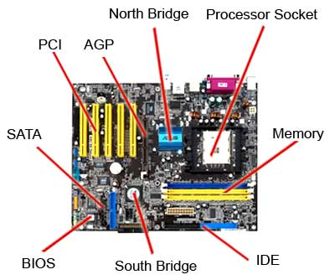
Motherboard

Slide 13
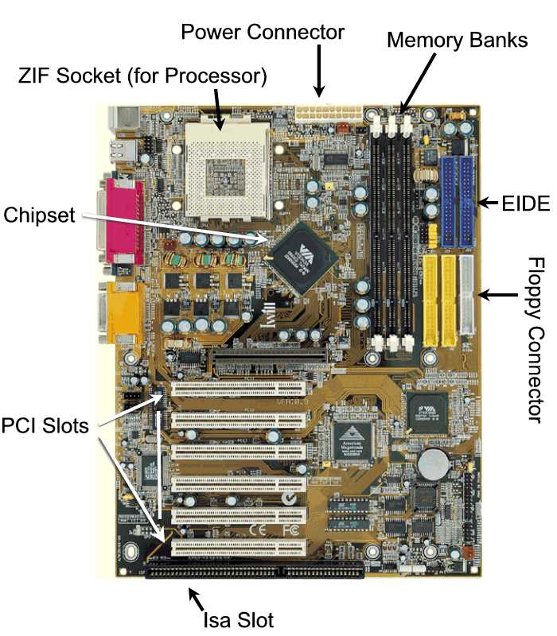

Slide 14
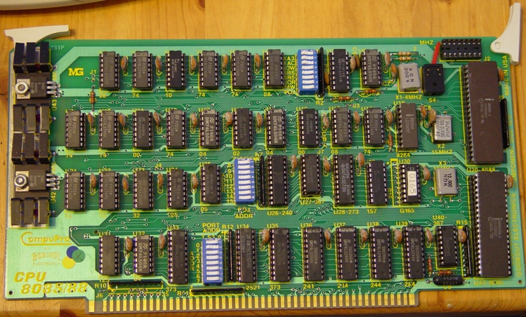
Previous Motherboard

Slide 15

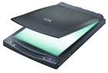
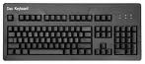
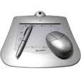
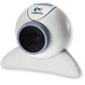
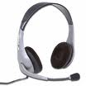
Input Devices

Slide 16
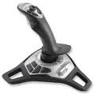
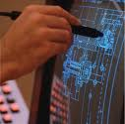
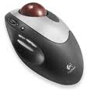
Input Devices

Slide 17
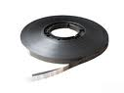
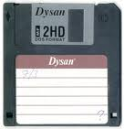
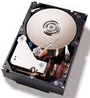
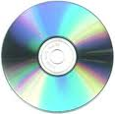
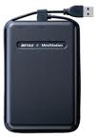
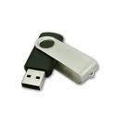
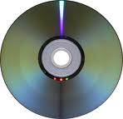
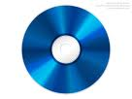
Memory Devices

Slide 18
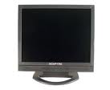
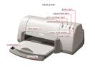
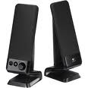
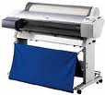
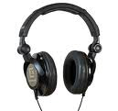
Output Devices

Slide 19
Evolution of computers
First Generation Computers (1940-1956)
Second Generation Computers (1956-1963)
Third Generation Computers (1964-1971)
Fourth Generation Computers (1971-Present)
Fifth Generation Computers (Present and Beyond)

Slide 20
First Generation Computers (1940-1956)
Main electronic component | Vacuum tube.
Programming language | Machine language.
Main memory | Magnetic tapes and magnetic drums.
Input/output devices | Paper tape and punched cards.
Speed and size | Very slow and very large in size (often taking up entire room).
Examples of the first generation | IBM 650, IBM 701, ENIAC, UNIVAC1, etc.

Slide 21
Second Generation Computers (1956-1963)
Main electronic component | Transistor.
Programming language | Machine language and assembly language.
Memory | Magnetic core and magnetic tape/disk.
Input/output devices | Magnetic tape and punched cards.
Power and size | Smaller in size, low power consumption, and generated less heat (in comparison with the first generation computers).
Examples of second generation | PDP-8, IBM1400 series, IBM 7090 and 7094, UNIVAC 1107, CDC 3600 etc.

Slide 22
Third Generation Computers (1964-1971)
Main electronic component | Integrated circuits (ICs)
Programming language | High-level language
Memory | Large magnetic core, magnetic tape/disk
Input / output devices | Magnetic tape, monitor, keyboard, printer, etc.
Examples of third generation | IBM 360, IBM 370, PDP-11, NCR 395, B6500, UNIVAC 1108, etc.

Slide 23
Fourth Generation Computers (1971-Present)
Main electronic component | Very large-scale integration (VLSI) and the microprocessor (VLSI has thousands of transistors on a single microchip).
Memory | semiconductor memory (such as RAM, ROM, etc.)
Input/output devices | pointing devices, optical scanning, keyboard, monitor, printer, etc.
Examples of fourth generation | IBM PC, STAR 1000, APPLE II, Apple Macintosh, Alter 8800, etc.

Slide 24
Fifth Generation Computers (Present and Beyond)
Main electronic component | Based on artificial intelligence, uses the Ultra Large-Scale Integration (ULSI) technology and parallel processing method (ULSI has millions of transistors on a single microchip and Parallel processing method use two or more microprocessors to run tasks simultaneously).
Language | Understand natural language (human language).
Size | Portable and small in size.
Input / output device | Trackpad (or touchpad), touchscreen, pen, speech input (recognize voice/speech), light scanner, printer, keyboard, monitor, mouse, etc.
Example of fifth generation | Desktops, laptops, tablets, smartphones, etc.

Slide 25
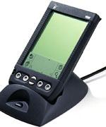
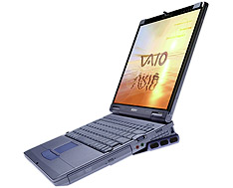
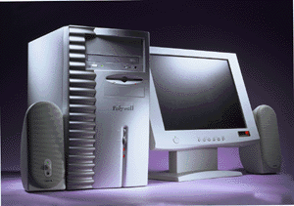
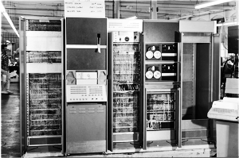
Designing Computers
All computers more or less based on the same basic design, the Von Neumann Architecture!

Slide 26
Von Neumann Architecture
Model for designing and building computers, based on the following three characteristics:
The computer consists of four main sub-systems:
Memory
ALU (Arithmetic/Logic Unit)
Control Unit
Input/Output System (I/O)
Von Neumann architecture is based on the stored-program computer concept, where instruction data and program data are stored in the same memory

Slide 27
The Von Neumann Architecture
Bus
Memory
Processor (CPU)
Input-Output
Registers
Control Unit
ALU
Communicate with
"outside world", e.g.
Screen
Keyboard
Storage devices
...
Store data and program
Execute program (Timing Siganls & Control Signals)
Do arithmetic/logic operations requested by program
Registers (collection flipplops) used for fast memory to hold data

Slide 28
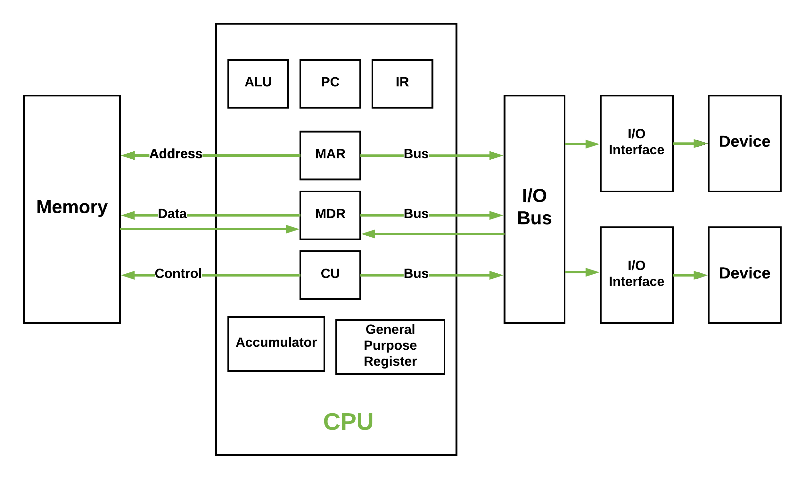
Instruction Architecture Set (IAS)

Slide 29
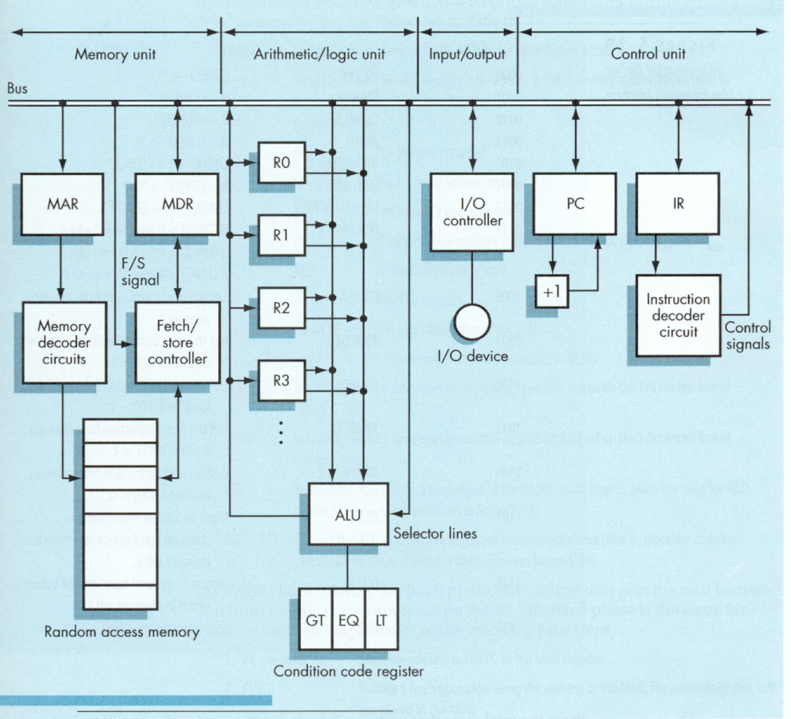
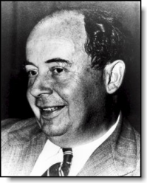
von Neumann
Architecture

Slide 30
The Von Neumann Architecture
Control Unit –
A control unit (CU) handles all processor control signals.
It directs all input and output flow, fetches code for instructions, and controls how data moves around the system.
Arithmetic and Logic Unit (ALU) –
The arithmetic logic unit is that part of the CPU that handles all the calculations the CPU may need, e.g. Addition, Subtraction, Comparisons.
It performs Logical Operations, Bit Shifting Operations, and Arithmetic operations.

Slide 31
The Von Neumann Architecture
Main Memory Unit (Registers) –
Accumulator: Stores the results of calculations made by ALU.
Program Counter (PC): Keeps track of the memory location of the next instructions to be dealt with. The PC then passes this next address to Memory Address Register (MAR).
Memory Address Register (MAR): It stores the memory locations of instructions that need to be fetched from memory or stored into memory.
Memory Data Register (MDR): It stores instructions fetched from memory or any data that is to be transferred to, and stored in, memory.
Current Instruction Register (CIR): It stores the most recently fetched instructions while it is waiting to be coded and executed.
Instruction Buffer Register (IBR): The instruction that is not to be executed immediately is placed in the instruction buffer register IBR.

Slide 32
The Von Neumann Architecture
Input/Output Devices –
Program or data is read into main memory from the input device or secondary storage under the control of CPU input instruction.
Output devices are used to output the information from a computer.
Buses –
Data is transmitted from one part of a computer to another, connecting all major internal components to the CPU and memory, by the means of Buses.
Types:
Data Bus: It carries data among the memory unit, the I/O devices, and the processor.
Address Bus: It carries the address of data (not the actual data) between memory and processor.
Control Bus: It carries control commands from the CPU (and status signals from other devices) in order to control and coordinate all the activities within the computer.

Slide 33
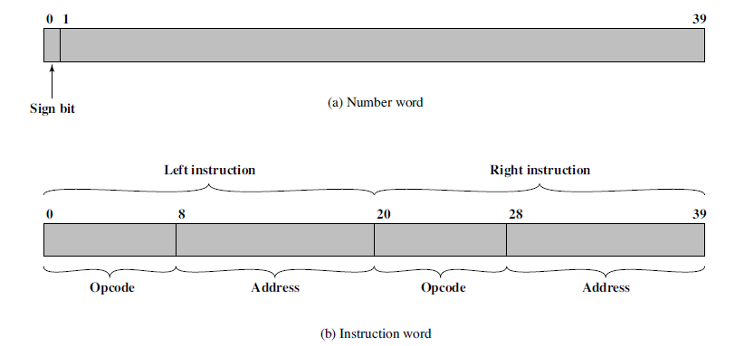
IAS Memory Formats
The IAS machine was a binary computer with a 40-bit word, storing two 20-bit instructions in each word

Slide 34
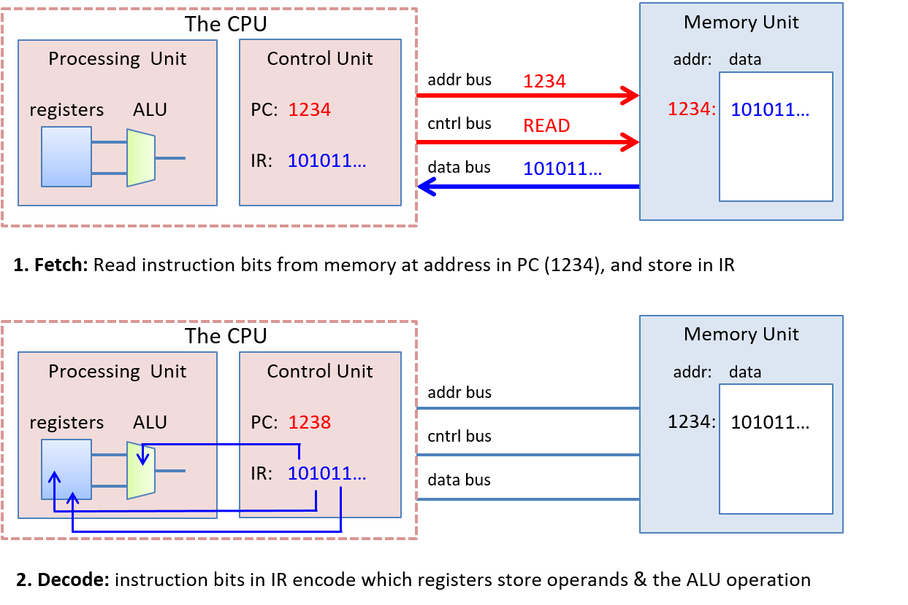

Slide 35
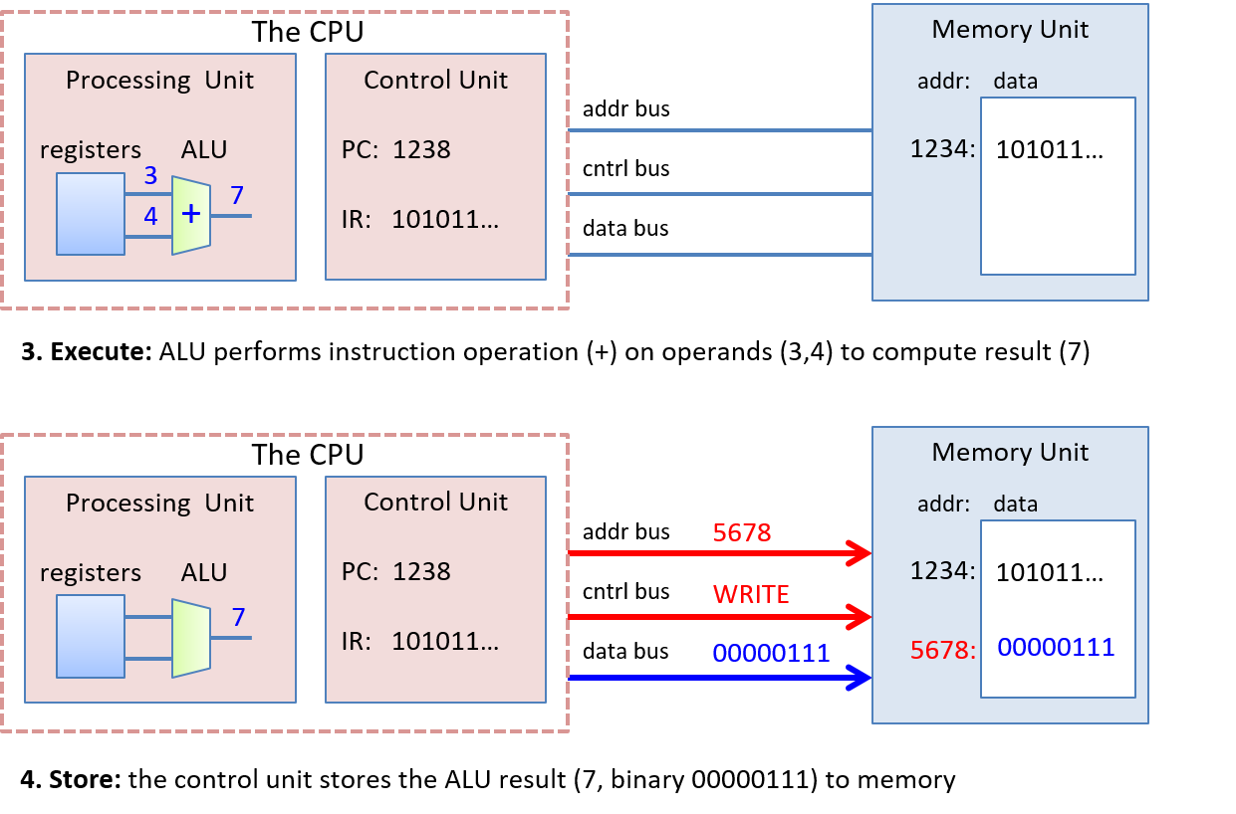

Slide 36
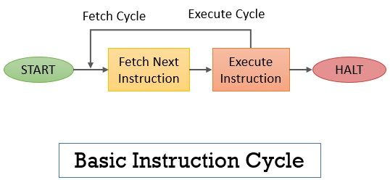
Instruction execution cycle

Slide 37
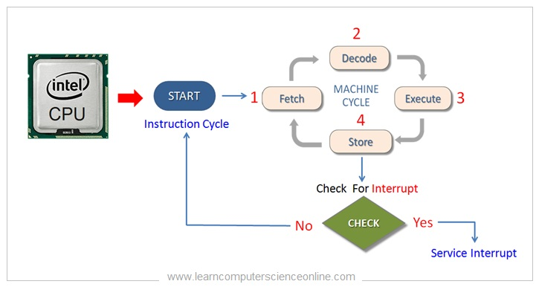

Slide 38
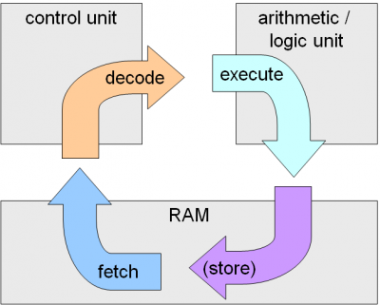

Slide 39
Each instruction cycle includes the following procedures −
It can fetch instruction from memory.
It is used to decode the instruction.
It can read the effective address from memory if the instruction has an indirect address.
It can execute the instruction.
After the above four procedures are done, the control switches back to the first step and repeats the similar process for the next instruction.
Therefore, the cycle continues until a Halt condition is met.
The halt condition appears when the device receive turned off, on the circumstance of unrecoverable errors, etc.

Slide 40
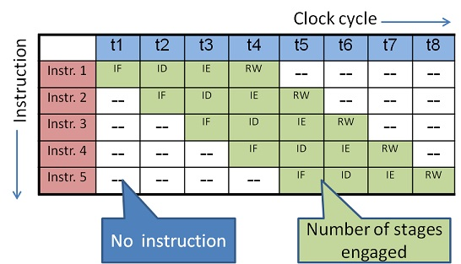
Instruction Pipeline

Slide 41
Evolution of Intel processor architecture- 4 bit to 64 bit
Presentation by Students

Slide 42
Interconnection Structures
A computer consists of a set of components (CPU,memory,I/O) that communicate with each other.
The collection of paths connecting the various modules is called as interconnection structure.
The design of this structure will depend on the exchange that must be made between modules.

Slide 43
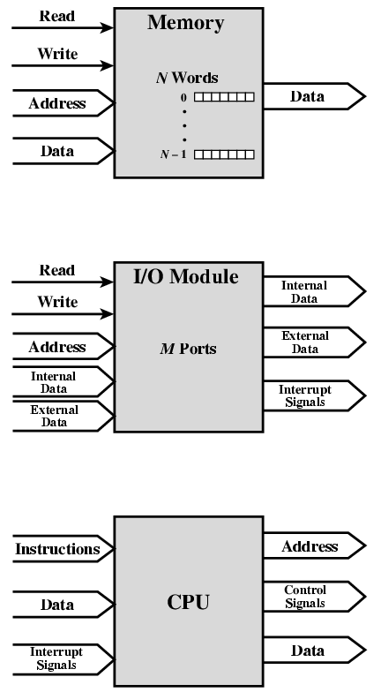
Computer Modules

Slide 44
Type of transfers
Memory to CPU
CPU to Memory
I/O to CPU
CPU to I/O
I/O to or from Memory (DMA)

Slide 45
Bus Interconnection
A bus is a communication pathway connecting two or more device.
A key characteristic of a bus is that it is a shared transmission medium.
A bus consists of multiple pathways or lines.
Each line is capable of transmitting signal representing binary digit (1 or 0)

Slide 46
Bus Interconnection
A sequence of bits can be transmit across a single line.
Several lines can be used to transmit bits simultaneously (in parallel).
A bus that connects major components (CPU,Memory,I/O) is called System Bus.
The most common computer interconnection structures are based on the use of one or more system buses.

Slide 47
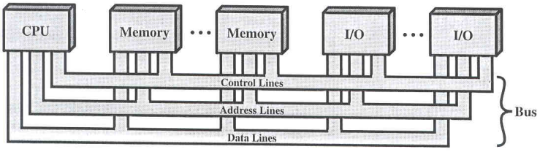
Bus Structure
A system bus consists of 50-100 lines.
Each line is assigned a particular meaning or function.
On any bus the lines can be classified into 3 groups
Data lines
Address lines
Control lines

Slide 48
Data Lines
Provide a path for moving data between system modules.
These lines, collectively, are called the data bus
The data bus typically consists of 8,16 or 32 separate lines, the numbers of lines being transferred to as the width of the data bus.
Each line carry only 1 bit at a time, the number of lines determines how many bits can transferred at a time - overall system performance.

Slide 49
The Address Lines
Used to designate the source or destination of the data on the data bus
The width of the address bus determines the maximum possible memory capacity of the system.

Slide 50
The Control Lines
Used to control the access to and the use of the data and address lines.
Typical control lines include
Memory write
Memory read
I/O write
I/O read
Clock
Reset
Bus request
Bus grant
Interrupt request
Interrupt ACK
Transfer ACK

Slide 51
The operation of the bus
If one module wishes to send data
obtain the use of the bus
transfer data via the bus
If one module wishes to request data
obtain the use of the bus
transfer request to the other module over the control and address lines, then wait for that second module to send the data.

Slide 52
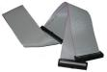
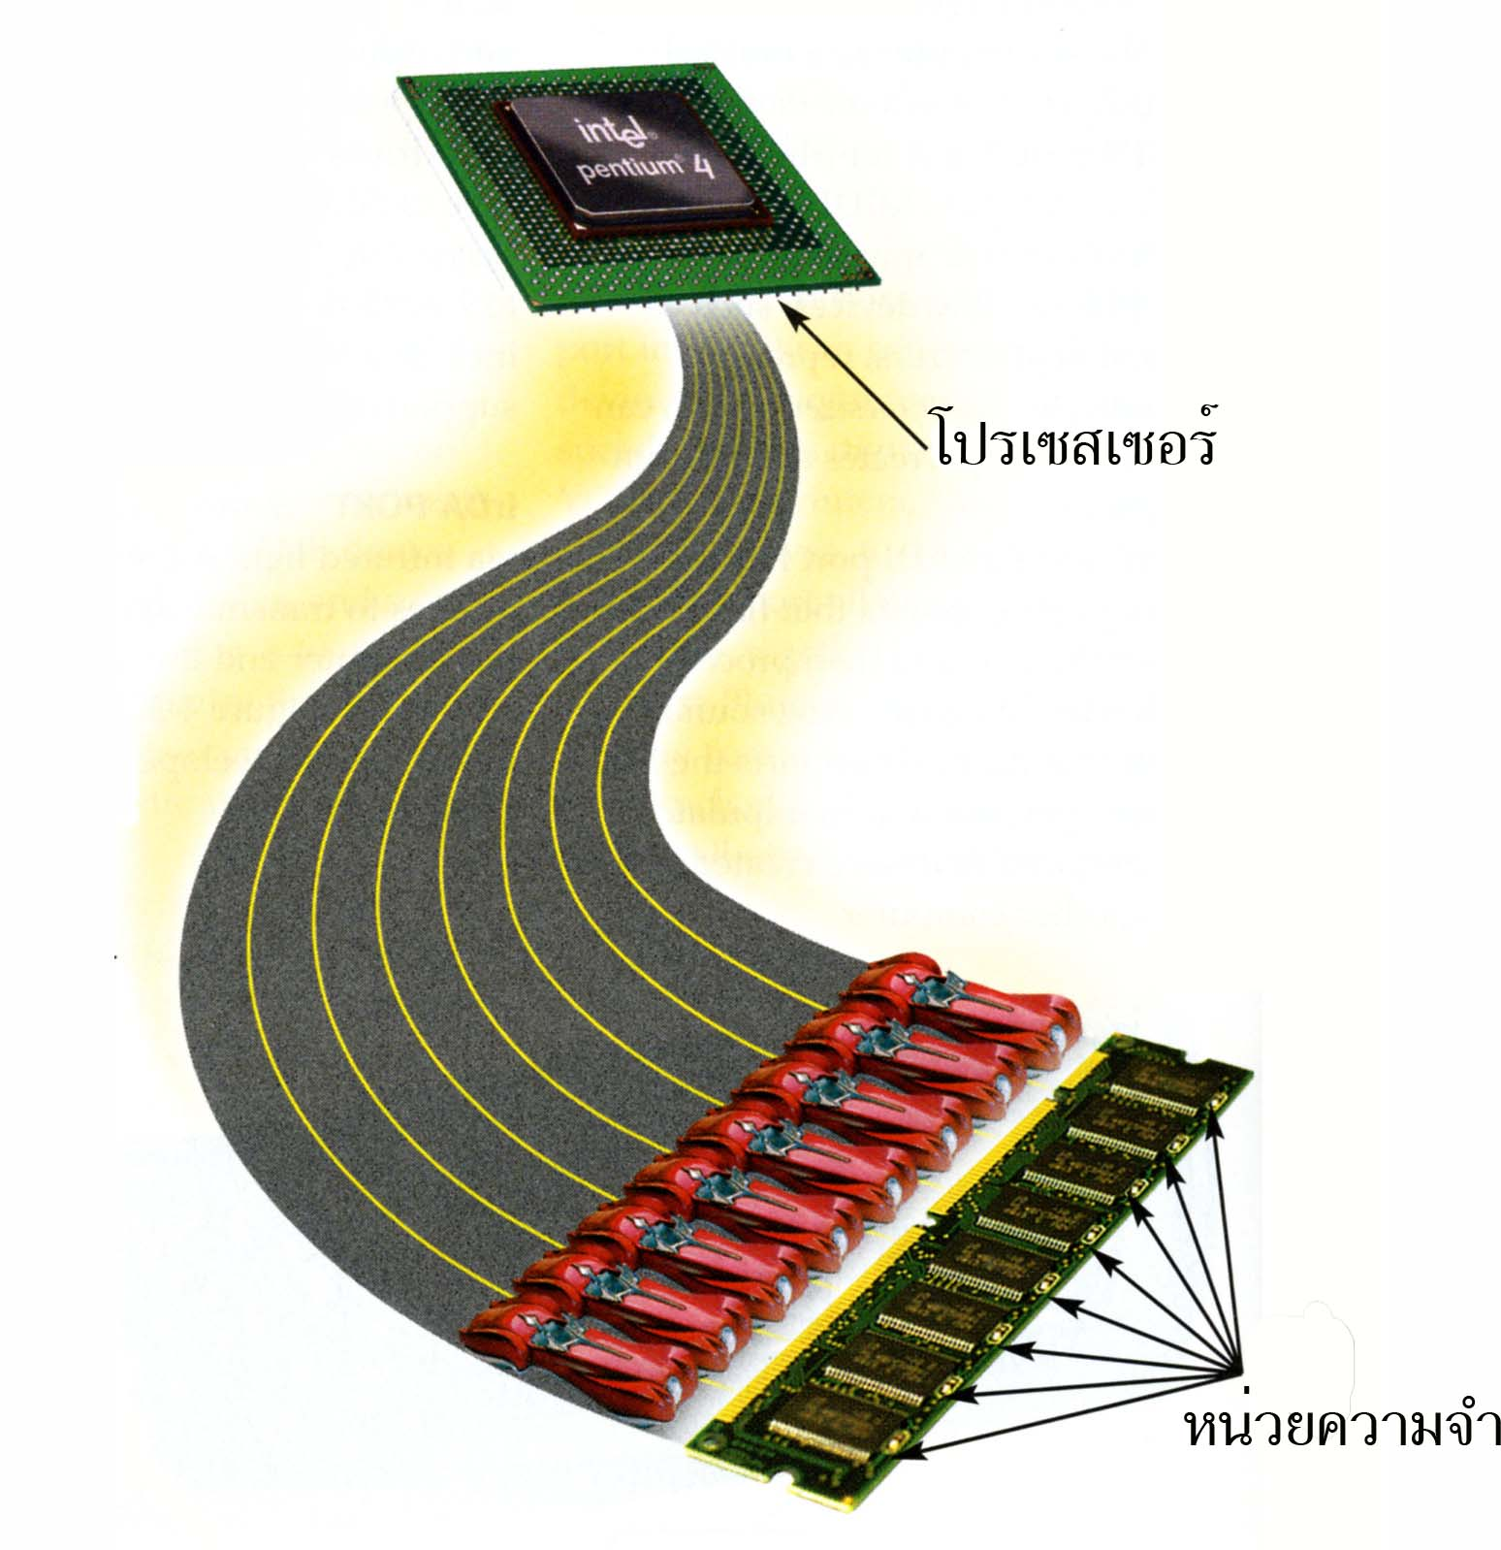
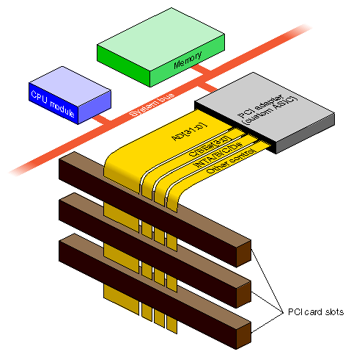
What do buses look like?

Slide 53
Bus Arbitration
In computer system one or more modules may need control of the data bus or address bus. E.g I/O module may need to read or write data directly in memory without sending data to a processor.
Because only one unit at a time can successfully transmit over the bus , some arbitration method is required.
Two approaches are followed for the bus Arbitration:
Centralized Bus Arbitration
Distributed Bus Arbitration

Slide 54
Centralized Bus Arbitration
In a centralized scheme, a single hardware device, referred to as bus controller/bus arbiter/bus master, is responsible for allocating time to requesting module.
Bus master can be a separate module or a part of processor.
Methods of Centralized BUS Arbitration:
Daisy Chaining Method
Polling or Rotating Priority method
Fixed priority or Independent Request method

Slide 55
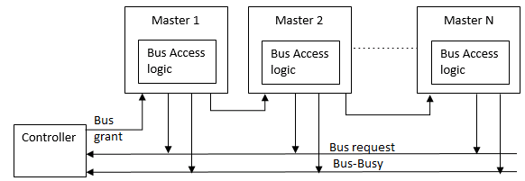
Daisy Chaining Method
It is a simple and cheaper method where all the bus masters use the same line for making bus requests.
The bus grant signal serially propagates through each master until it encounters the first one that is requesting access to the bus.
This master blocks the propagation of the bus grant signal by sending bus busy status.
Therefore any other requesting module will not receive the grant signal and hence cannot access the bus.

Slide 56
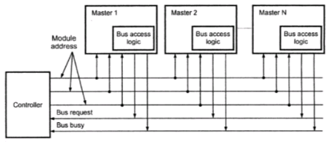
Polling or Rotating Priority method
In this, the controller is used to generate the address for the master(unique priority), the number of address lines required depends on the number of masters connected in the system.
The controller generates a sequence of master addresses. When the requesting master recognizes its address, it activates the busy line and begins to use the bus.

Slide 57
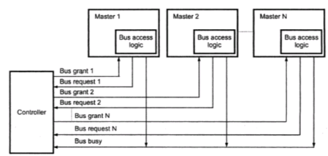
Fixed priority or Independent Request method
In this, each master has a separate pair of bus request and bus grant lines and each pair has a priority assigned to it.
The built-in priority decoder within the controller selects the highest priority request and asserts the corresponding bus grant signal.

Slide 58
Distributed Bus Arbitration
In distributed arbitration, all devices participate in the selection of the next bus master.
In this scheme each device on the bus is assigned a 4-bit identification number.
The number of devices connected on the bus when one or more devices request for the control of bus, they assert the start-arbitration signal and place their 4-bit ID numbers on arbitration lines, ARB0 through ARB3.
These four arbitration lines are all open-collector.
Therefore, more than one device can place their 4-bit ID number to indicate that they need to control of bus

Slide 59
Asynchronous and synchronous bus
Asynchronous bus
A bus that interconnects devices of a computer system where information transfers between devices are self-timed rather than controlled by a synchronizing clock signal.
A connected device indicates its readiness for a transfer by activating a request signal. For example, communication via fax or voice mail are all forms of asynchronous communication.
low speed buses are asynchronous.
Synchronous bus
A bus used to interconnect devices that comprise a computer system where the timing of transactions between devices is under the control of a synchronizing clock signal.
For example, a telephone conservation, a video conference and a chat room discussion are all forms of synchronous communication.
High speed buses are generally synchronous

